Slide 1
Open Data Science Workshop
David Tarrant · @davetaz
Notes:
non-profit, non-partisan
Founded 1 year ago
15 full time employees
TBL and Nigel Shadbold
SPACE TO CONVENE, help others use data

Slide 2
Workshop aim
Identify opportunities to improve data science capability and capacity within the organisation.

Slide 3
Outcomes
Explain the key characteristics of a data scientist
Analyse your own capability and capacity as a data scientist
Describe a number of data science examples
Understand the changing nature of open data science
Identify a number of open data science tools
Create a plan for the future of data science in your organisation

Slide 4
Schedule
Part 1: Introducing data science
Part 2: Data science in action
Part 3: The data science toolkit
Part 4: Action planning

Slide 5
Question
What is data science?

Slide 6
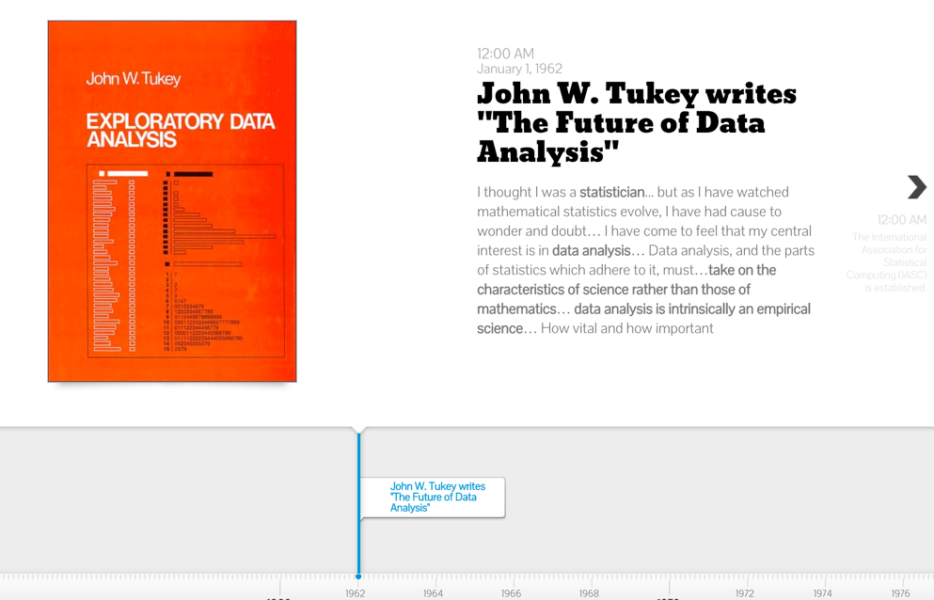
History of data science

Slide 7
Exercise
Your data science capability and capacity
Individually, then together on A3

Slide 8
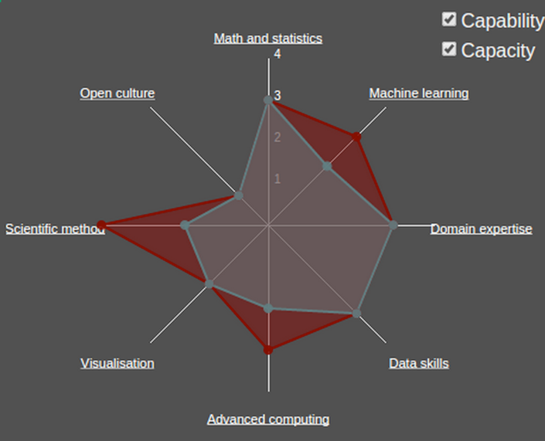
Data science

Slide 9
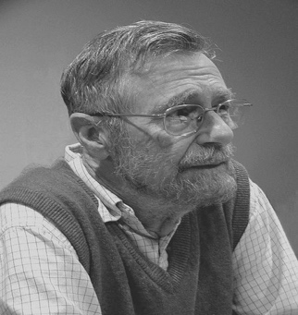
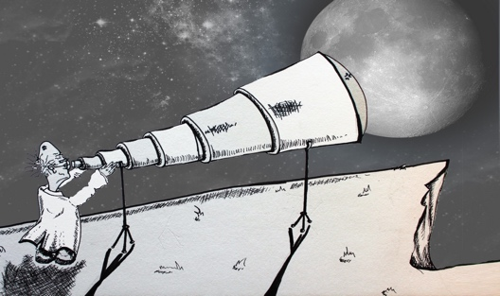
Computer Science = Telescope science ?
"Computer science is no more about computers
than astronomy is about telescopes” -- Edsger W. Dijkstra
“The computer is not our object of study,
It’s our observational instrument”
Thanks to Frank van Harmelen

Slide 10
Schedule
Part 1: Introducing data science
Part 2: Data science in action
Part 3: The data science toolkit
Part 4: Action planning

Slide 11
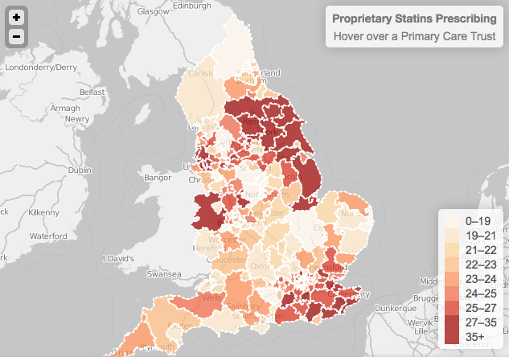



£200m potential saving identified in 6 weeks
Convened domain-experts + health & data analytics + communications
Analysed 35m records + all the data & clinical facts
National & international reach
+ Economist & FT
+ broadsheets & tabloid press
+ cited in G8 & govt. reports
Scalable to £1^{bn} [BMJ]
http://theodi.org/stories

Slide 12
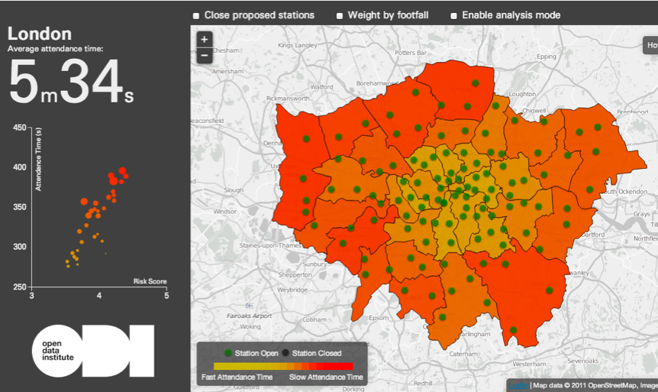
Tools that aid policy makers and are open to the public
Convened domain experts
+ Fire service
+ Smart-steps intelligence (Telefonica)
+ Data analytics (ODI)
Real-time big data processing
+ 509,000 incidents over (4y+)
+ 120,000 network stations
+ 600,000,000 location records
1 expert analysis tool
+ Making cities smarter
+ View impact on people, the
borough, and whole city
http://theodi.org/stories

Slide 13
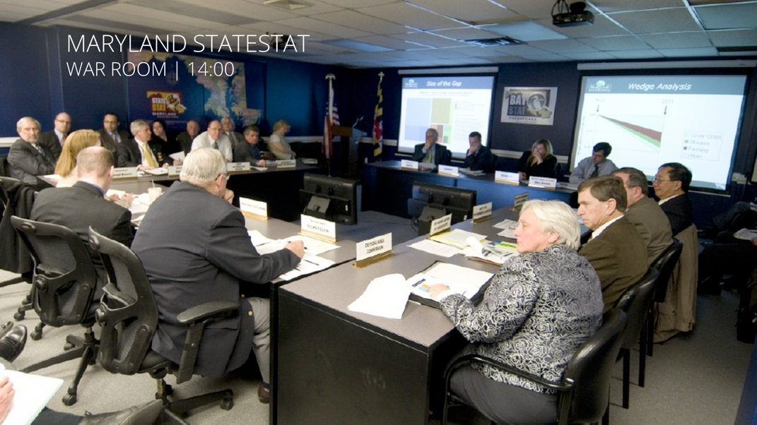
The Future?

Slide 14
Exercise
What example has inspired you?
1 sentence

Slide 15
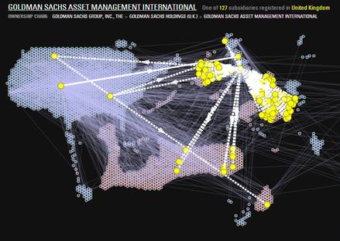
Mapping the beneficial ownership of US banks
Innovative open insight
+ Mapped the biggest US banks
+ Groundbreaking visualisation
+ Enables new financial analysis
Aggregated and cleaned data
+ Extracted from huge PDFs
+ Over 900 pages
+ Combined with public data
Featured internationally
+ Wired
+ GigaOm
Development opportunities
+ Map network changes
+ Find patterns and trends
http://theodi.org/stories

Slide 16
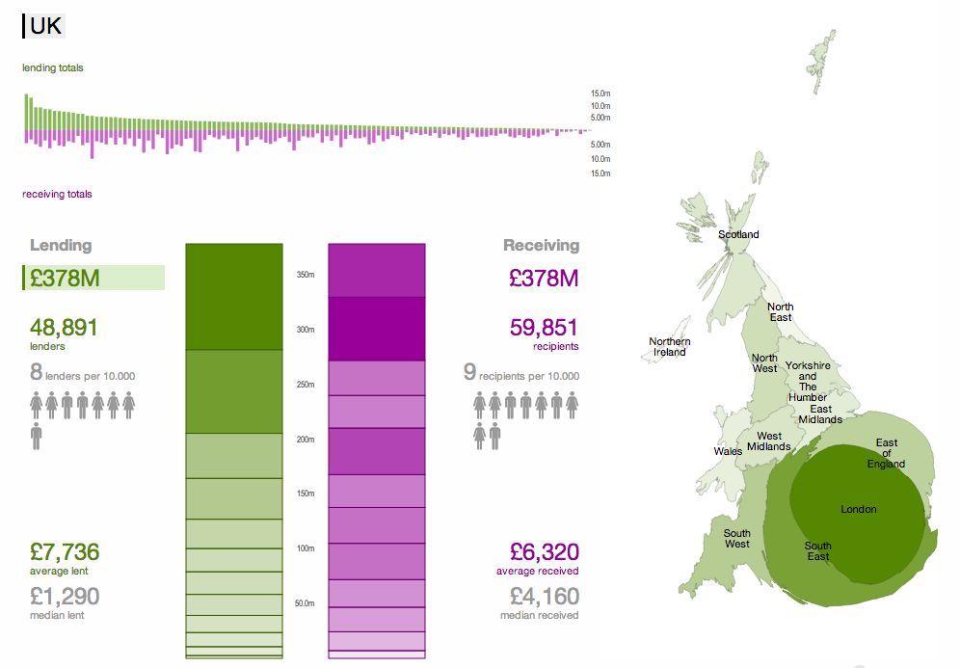
Mapping £378m of peer-to-peer lending
Convened domain-experts + P2P lenders + Banking professionals
+ Data analytics (ODI) + Communications (ODI)
Analysed 14m records + All the data (i.e. not a model)
+ Anonymised and analysed
+ ODI analytics & research
National & international reach
+ Front-page Financial Times
Development opportunities
+ Data intensive & policy-light
+ Create real-time view
+ Stimulate market
http://theodi.org/stories

Slide 17
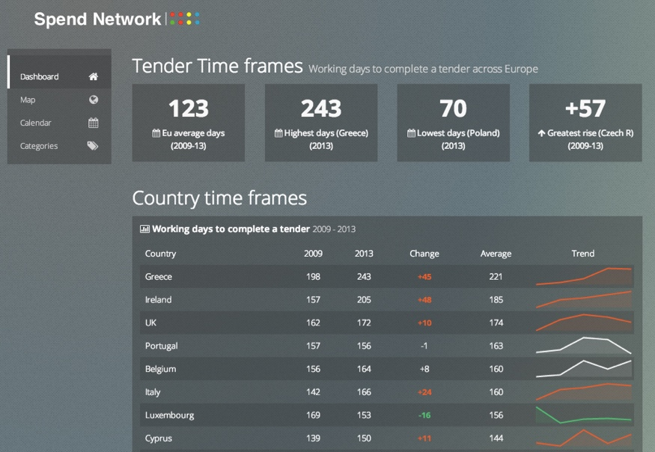
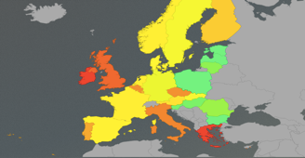
Identifying £22bn of cashflow delay to the UK economy
Convened domain experts
+ Entrepreneur think-tanks
+ Federation of small businesses
+ Government procurement
Analysed and cleaned data
+ 350,000 EU tenders
+ 38 million UK transactions
+ 1.8m documents + 9,000 CSVs
National reach
+ Front-page Daily Telegraph
(Business Section)
Development opportunities
+ Discover & address issues
+ Predictive bid analytics
http://theodi.org/stories

Slide 18
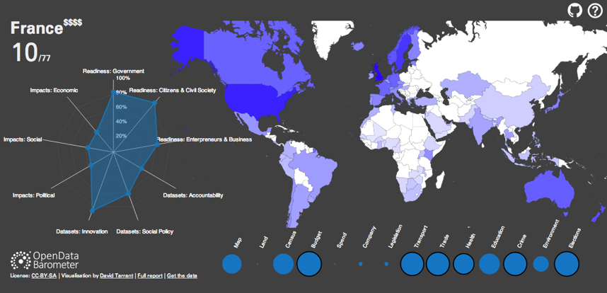


Insight into open data policy around the world
Readiness Political, social and economic. Government, entrepreneurs, business, citizens, civil society.
Implementation
Measuring progress on 14 core datasets (e.g. land, spending, transport, crime, health)
Impact
Analysis of positive political, social and environmental impact, and economic change.
http://theodi.org/stories

Slide 19
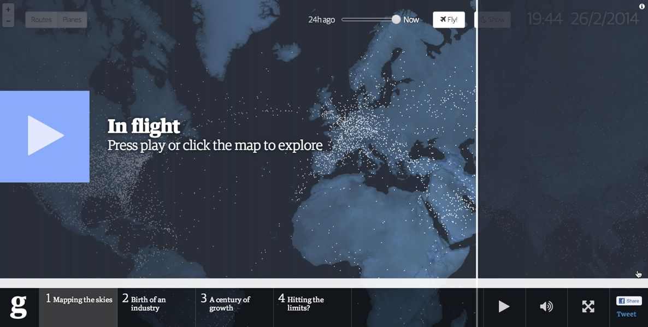
Telling the story of aviation, now and in the future
http://aviation.live.kiln.it/

Slide 20
Schedule
Part 1: Introducing data science
Part 2: Data science in action
Part 3: The data science toolkit
Part 4: Action planning

Slide 21
The data science toolkit
Open Refine
R-Studio
Socrata / Tableau
HTML5
….

Slide 22
Schedule
Part 1: Introducing data science
Part 2: Data science in action
Part 3: The data science toolkit
Part 4: Action planning

Slide 23
Exercise
What are your priorities?
Top 3 per group
Please help us to help you by completing
bit.ly/edsas

Slide 24
Thank-you

